Slide 1
Outline:
Introduction.
Descriptions: positions, orientations and frames.
Mappings: changing description from frame to frame
Operators: translations, rotations, and transformations

Slide 2
Introduction:
Location of an object in 3D space?
Robot links
Robot tool
Parts in the Workspace (WS )
Environment (obstacles, walls…)
Position & orientation
How to represent these quantities mathematically?
Attach frame (coordinate system) to each object rigidly.
Find the transformation between these frames

Slide 3
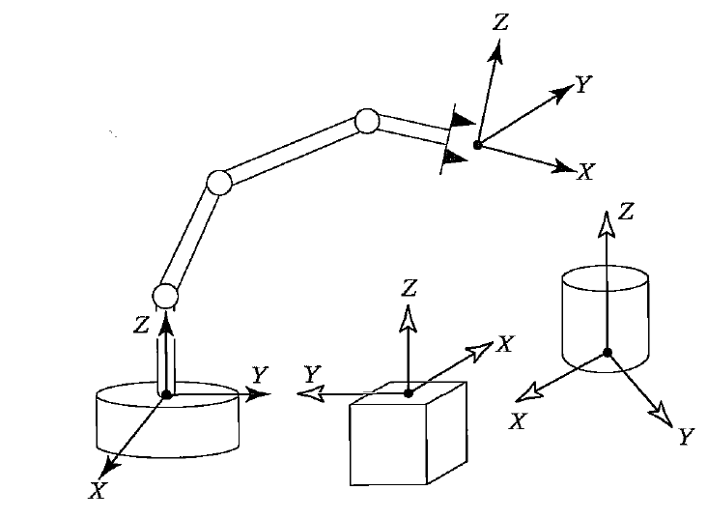
Introduction
Frames attachment.
Don’t forget to define the universe frame
Mapping between these frames

Slide 4
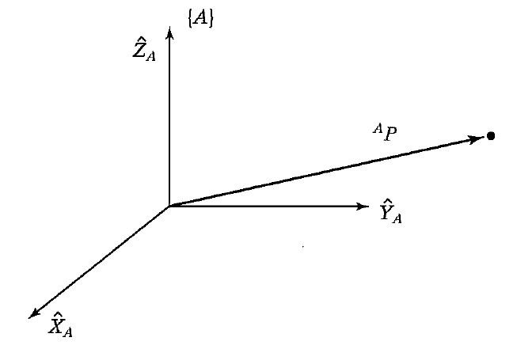
Descriptions: positions, orientations and frames
Position
{A} ≡ frame A
≡ the 3D position vector of point P calculated in {A}

Slide 5
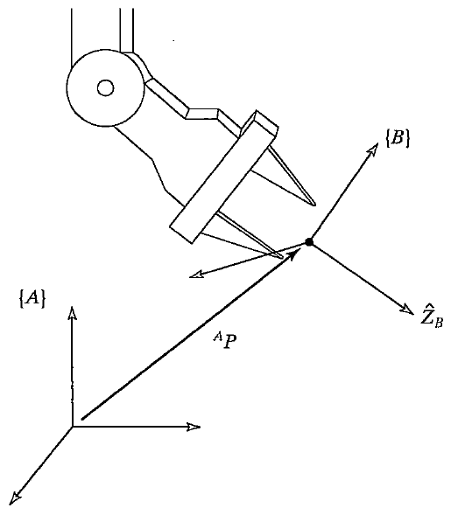
Descriptions: positions, orientations and frames
Orientation?
Position in 3D-space is not enough, the orientation must be also described.
How to describe the orientation of {B} relative to {A}?
One possible solution:
Decompose the unit vector directions of {B} (${\hat{X}}_{B},$ ${\hat{Y}}_{B},$ ${\hat{Z}}_{B}$) in {A}, as follows:
${}_{}^{A}{{\hat{X}}_{B}=\left[\begin{matrix}{\left({{}_{}^{A}{\hat{X}}}_{B}\right)}_{x} \\ {\left({{}_{}^{A}{\hat{X}}}_{B}\right)}_{y} \\ {\left({{}_{}^{A}{\hat{X}}}_{B}\right)}_{z}\end{matrix}\right]}$
similarly for ${}_{}^{A}{{\hat{Y}}_{B}}$ and ${}_{}^{A}{{\hat{Z}}_{B}}.$

Slide 6
Descriptions: positions, orientations and frames
Orientation?
if we put ${}_{}^{A}{{\hat{X}}_{B}},{}_{}^{A}{{\hat{Y}}_{B}},{}_{}^{A}{{\hat{Z}}_{B}}$ in one matrix
${}_{B}^{A}R=\left[\begin{matrix}{}_{}^{A}{{\hat{X}}_{B}} & {}_{}^{A}{{\hat{Y}}_{B}} & {}_{}^{A}{{\hat{Z}}_{B}}\end{matrix}\right]$
${}_{B}^{A}R=\left[\begin{matrix}r_{11} & r_{12} & r_{13} \\ r_{21} & r_{22} & r_{23} \\ r_{31} & r_{32} & r_{33}\end{matrix}\right]$
${}_{B}^{A}R$ = 3x3 Rotation matrix between
{A} and {B}, {B} expressed
in {A}
➔ complete description:
{B} =

Slide 7
Descriptions: positions, orientations and frames
Orientation?
Note that,
and is the dot-product which is equivalent to the cosine of the angle between these two vectors.
Also,
Hence,

Slide 8
Descriptions: positions, orientations and frames
Rotation matrix characteristics:
All columns have unit magnitude
And they are orthogonal
Orthonormal matrix

Slide 9
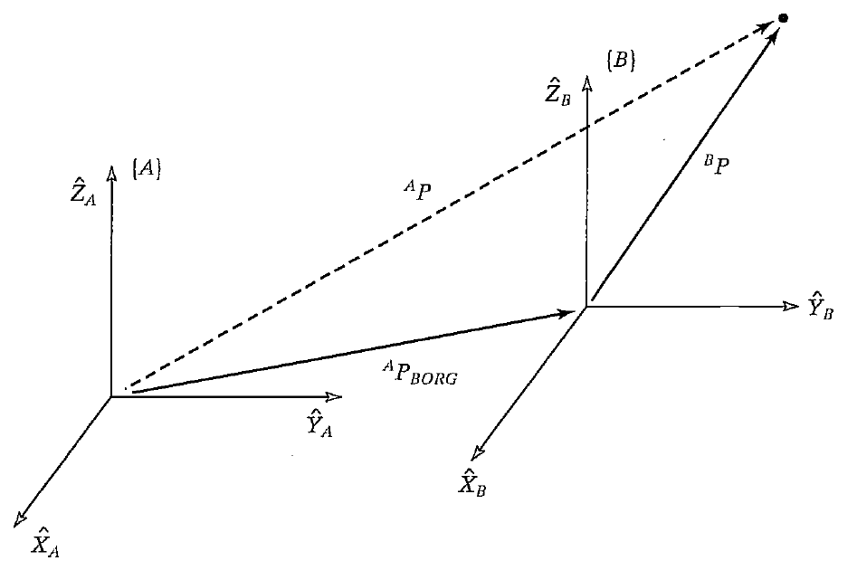
Mapping (changing description from frame to frame)
Translation without rotation
Assume {A} and {B}, and . What is if {A} and {B} have the same orientation?

Slide 10
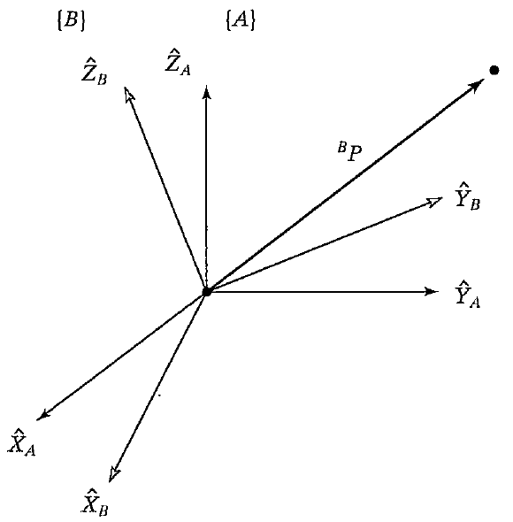
Mapping (changing description from frame to frame)
Rotation without translation
≡ Rotation matrix between {A} and {B}
Note that
In matrix form

Slide 11
Mapping (changing description from frame to frame)

Slide 12
Mapping (changing description from frame to frame)
Note that the vector P is not changing in space, but we are calculating its description in different frame
Solution

Slide 13
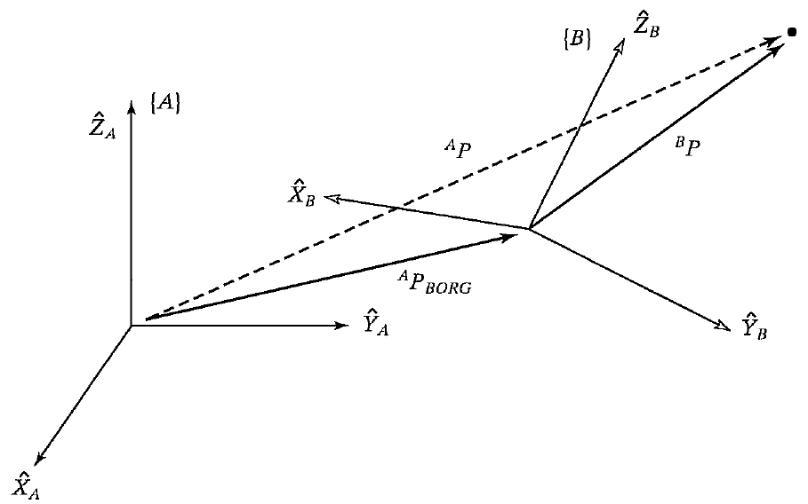
Mapping (changing description from frame to frame)
Translation and rotation In more compact form
Or,
(4x1) vectors

Slide 14
Mapping (changing description from frame to frame)
Translation and rotation In more compact form
Or,
(4x1) vectors
Homogeneous transform ≡ trans.+rot. in a single matrix
≡ Complete description of {B} relative to {A}
More computations (disadvantage)

Slide 15
Mapping (changing description from frame to frame)

Slide 16
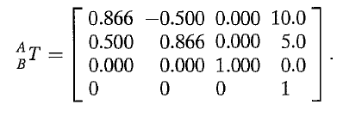
Mapping (changing description from frame to frame)
Solution

Slide 17
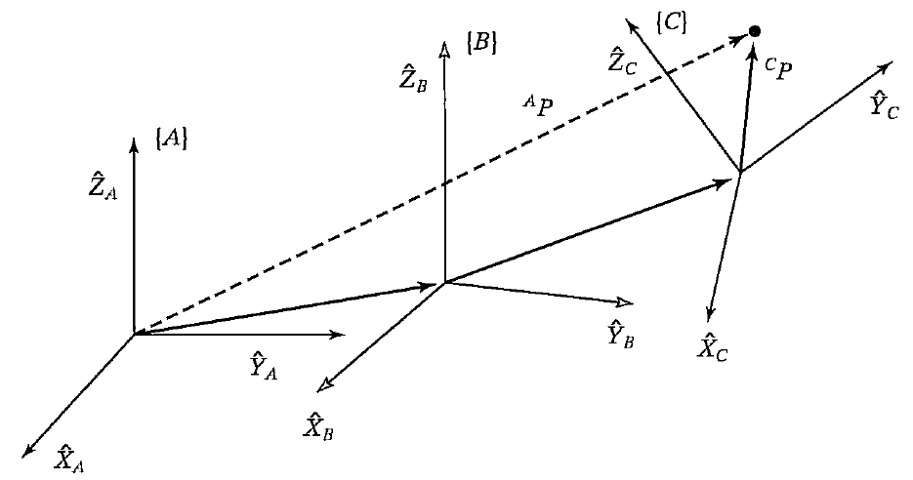
Transformation operations: (Multiplication and inversion)
Multiplication (Compound transformation)

Slide 18
Transformation operations: (Multiplication and inversion)
Inverse

Slide 19
Transformation operations: (Multiplication and inversion)
Inverse (example 2.5)
Given
Find

Slide 20
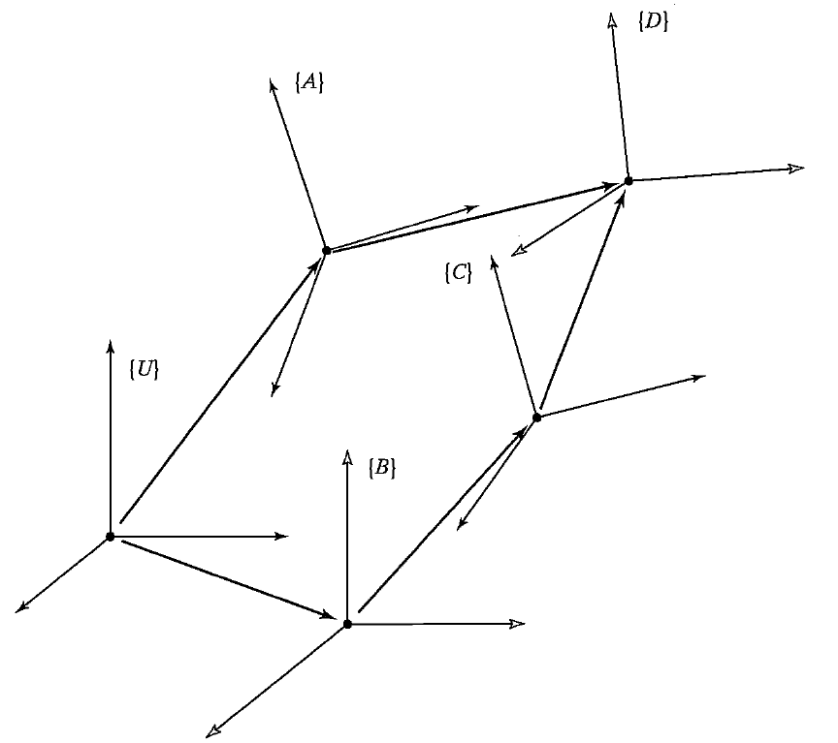
Graphical Representation of the Transform
Arrow directions indicate
transformation between frames:
i.e.:
{A} is defined in {U}, {D} in {A},
{C} in {B}… etc.
Arrow direction:
Same direction
{U} to {A} ➔
Opposite direction
{U} to {A} ➔

Slide 21
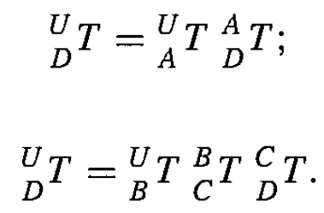
Graphical Representation of the Transform
From the figure
Suppose is unknown
find it!

Slide 22
Graphical Representation of the Transform
From the figure
Suppose is unknown
find it!

Slide 23
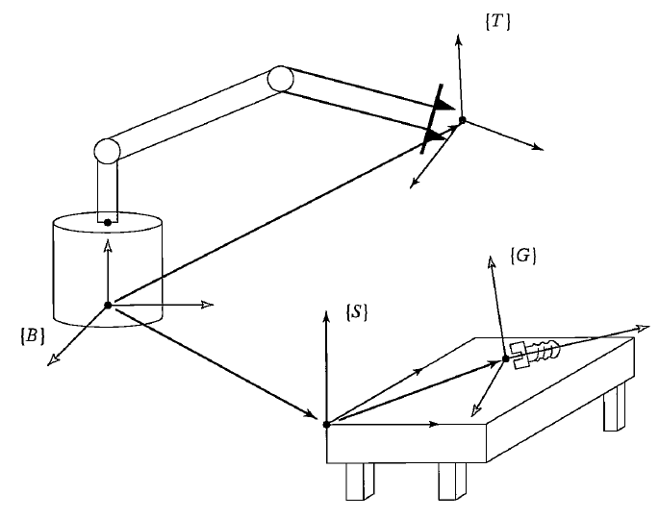
Graphical Representation of the Transform

Slide 24
More on Representation of Orientation
Orientation Variables:
9 variables: Note that in 3D-space 3 independent variables are required to describe the orientation.
9 variables + 6 constraint equations ➔ 3 independent variables
Constraint equations:
Remark: generally, rotations are not commute,
Describe the orientation using 3 parameters would be simpler

Slide 25
More on Representation of Orientation
Example:

Slide 26
Orientation description using 3 angular parameters:
Roll, Pitch, Yaw angles (rotation about fixed axes XYZ)
{A} and {B} are initially coincident (have the same orientation)
Rotate {B} about ${\hat{X}}_{A}$ by an angle γ
Rotate {B} about ${\hat{Y}}_{A}$ by an angle β
Rotate {B} about ${\hat{Z}}_{A}$ by an angle α
(γ, β, α) ≡ (roll, pitch, yaw) angles

Slide 27
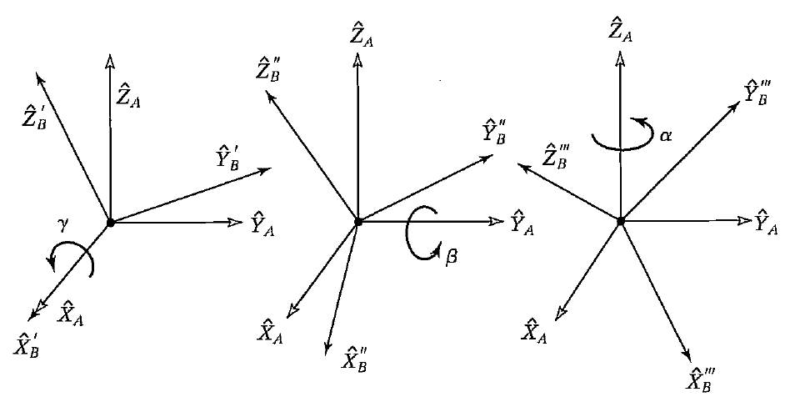
Orientation description using 3 angular parameters:
Roll, Pitch, Yaw angles (rotation about fixed axes XYZ)
(${\hat{X}}_{A}$,γ), (${\hat{Y}}_{A}$,β), (${\hat{Z}}_{A}$, α)

Slide 28
Orientation description using 3 angular parameters:
Roll, Pitch, Yaw angles (rotation about fixed axes XYZ)
(${\hat{X}}_{A}$,γ), (${\hat{Y}}_{A}$,β), (${\hat{Z}}_{A}$, α)

Slide 29
Orientation description using 3 angular parameters:
Roll, Pitch, Yaw angles (rotation about fixed axes XYZ)
(${\hat{X}}_{A}$,γ), (${\hat{Y}}_{A}$,β), (${\hat{Z}}_{A}$, α)
The order is a must!
cα = cos(α), cβ = cos(β), c γ = cos(γ),

Slide 30
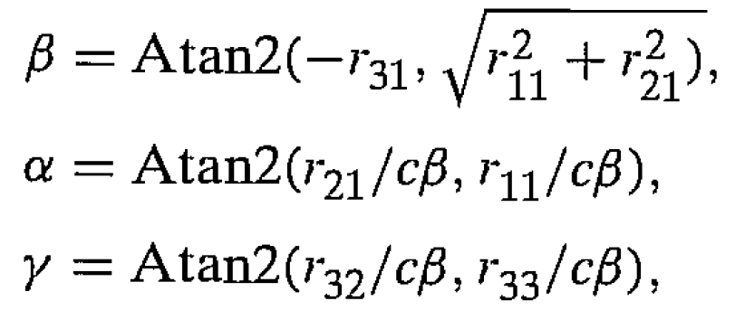
Orientation description using 3 angular parameters:
Roll, Pitch, Yaw angles (rotation about fixed axes XYZ)
Given , determine (α, β, γ)? (Inverse problem)
Solution:
If cβ ≠ 0,
Atan2(y,x)?

Slide 31
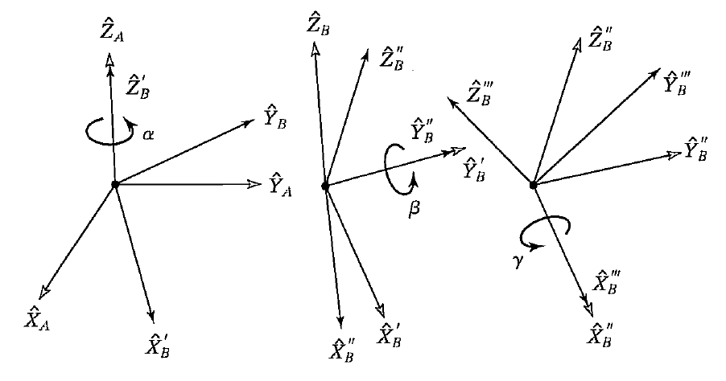
Orientation description using 3 angular parameters:
Z-Y-X Euler Angles: Rotation about moving axes
{A} and {B} are initially coincident (have the same orientation)
Rotate {B} about ${\hat{Z}}_{B}$ by an angle α
Rotate {B} about ${\hat{Y}}_{B}$ by an angle β
Rotate {B} about ${\hat{X}}_{B}$ by an angle γ

Slide 32
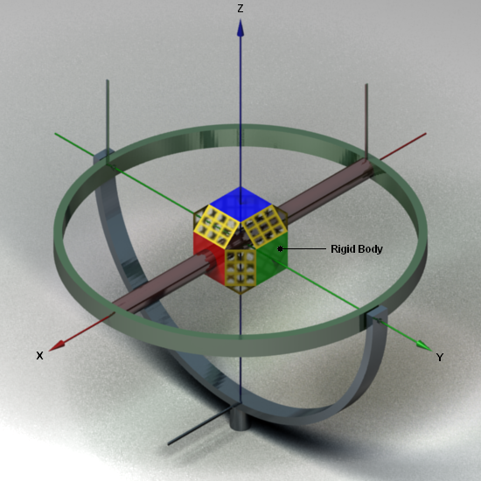
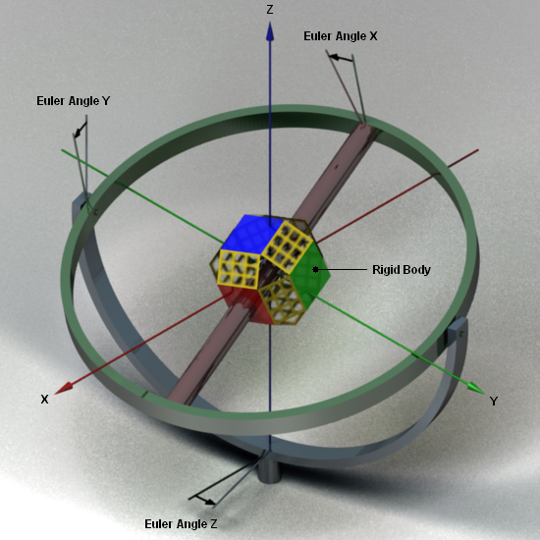
Orientation description using 3 angular parameters:
Z-Y-X Euler Angles: Rotation about moving axes
{A} and {B} are initially coincident (have the same orientation)
Rotate {B} about ${\hat{X}}_{A}$ by an angle γ
Rotate {B} about ${\hat{Y}}_{A}$ by an angle β
Rotate {B} about ${\hat{Z}}_{A}$ by an angle α
(γ, β, α) ≡ (roll, pitch, yaw) angles

Slide 33
Orientation description using 3 angular parameters:
Z-Y-X Euler Angles: Rotation about moving axes

Slide 34
Orientation description using 3 angular parameters:
Z-Y-X Euler Angles: Rotation about moving axes
{A} and {B} are initially coincident (have the same orientation)
Rotate {B} about ${\hat{Z}}_{B}$ by an angle α
Rotate {B} about ${\hat{Y}}_{B}$ by an angle β
Rotate {B} about ${\hat{X}}_{B}$ by an angle γ
The same as obtained before, however in fixed axes
rotations, rotations have opposite order!

Slide 35
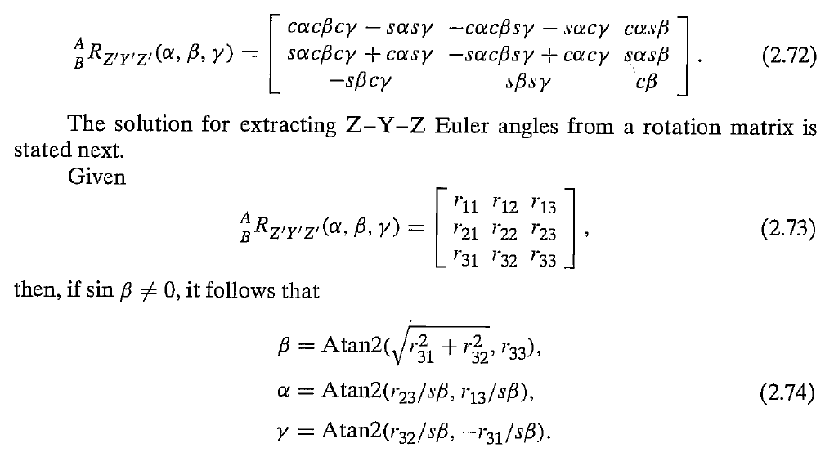
Orientation description using 3 angular parameters:
Z-Y-Z Euler Angles:
The same as Z-Y-X procedure, however the last rotation is around ${\hat{Z}}_{B}$

Slide 36
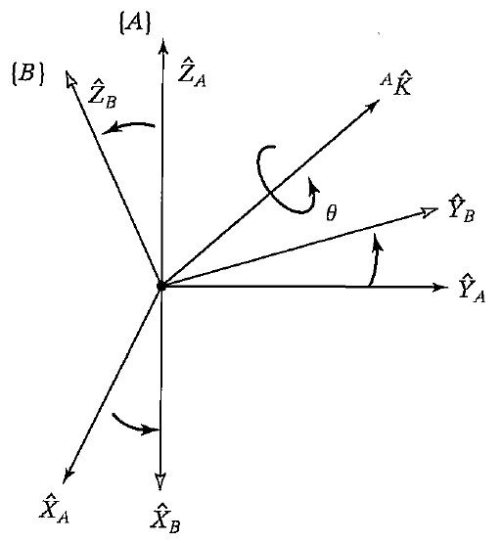
Equivalent Angle-Axis Representation:
Any relative orientation can be described by a rotation by an angle θ around a given axis (direction)
Angle + direction vector ≡ 3 independent variables
θ
Axis of rotation
Only 2 are independent

Slide 37
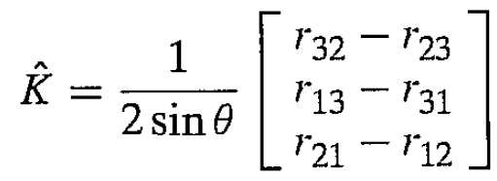
Equivalent Angle-Axis Representation:
Given θ and $\hat{K}$, find R
Given R, find θ and $\hat{K}$

Slide 38
Equivalent Angle-Axis Representation:

